Slide 1

Evaluating AI’s Impact on Society -Prospects, Perils and The Path Forward

Artificial Intelligence could spell the end of the human race
-Dr Steven Hawking


Slide 2
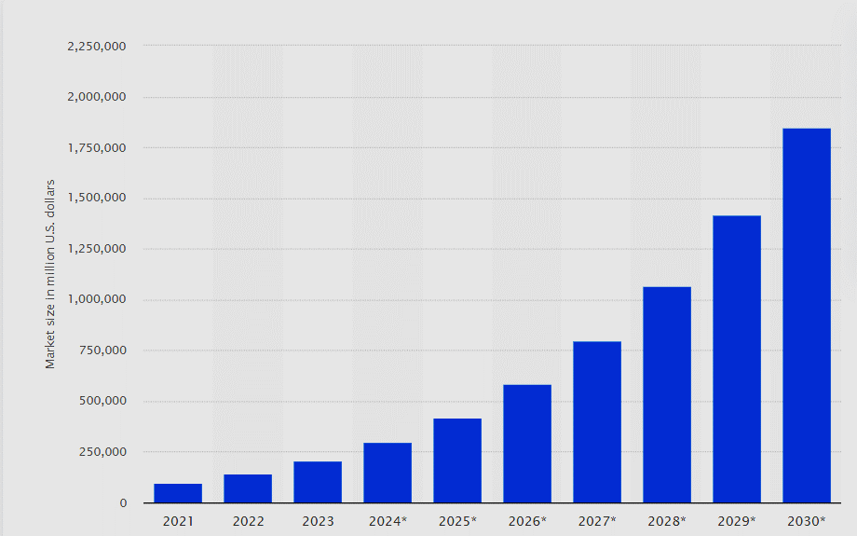
Increasing Importance of AI
Global market value of $241 billion in 2023
Projected to reach almost $2 trillion by 2030
53% of all businesses report using AI to assist or enhance their services
Projected to increase profits in varying industries:
Education – 84%
Construction – 71%
Healthcare – 55%
As we watch AI become increasingly common in our world, should we embrace the changes and ease it brings to our lives, or should we become increasingly weary of its intelligence and seemingly boundless growth?
AI Global Market Size Forecast until 2030 (Next Move Strategy Consulting, 2023)

Slide 3
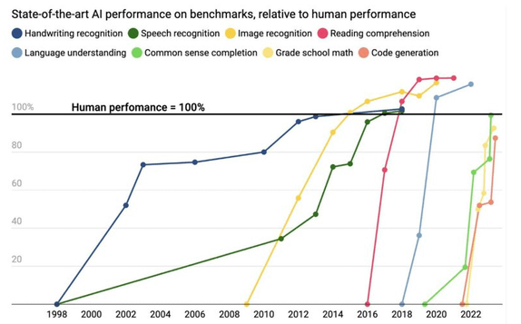
Development of AI models
AI models have surpassed human ability in pattern recognition tasks since the mid 2010’s
Approaching the mid 2020’s AI models are reaching human ability at more complex tasks such as mathematical calculations and text or code generation.
Where a human takes years of learning and experience to develop their skills, an AI model can be trained in a matter of weeks.
A study conducted by Seoul National University Hospital found that the deep-learning AI model they had developed was able to analyse chest radiographs and detect abnormal cell growth and potential cancers.
Not only was its diagnosis correct but it outperformed 17 out of 18 trained physicians (Nam and Park et al., 2018).
It’s this very element of ‘training vs performance’ which makes AI so profound.
The level of performance these models can reach is not limited by human factors, meaning in many tasks – often pattern recognition or data analysis – AI rapidly surpasses human ability

Slide 4
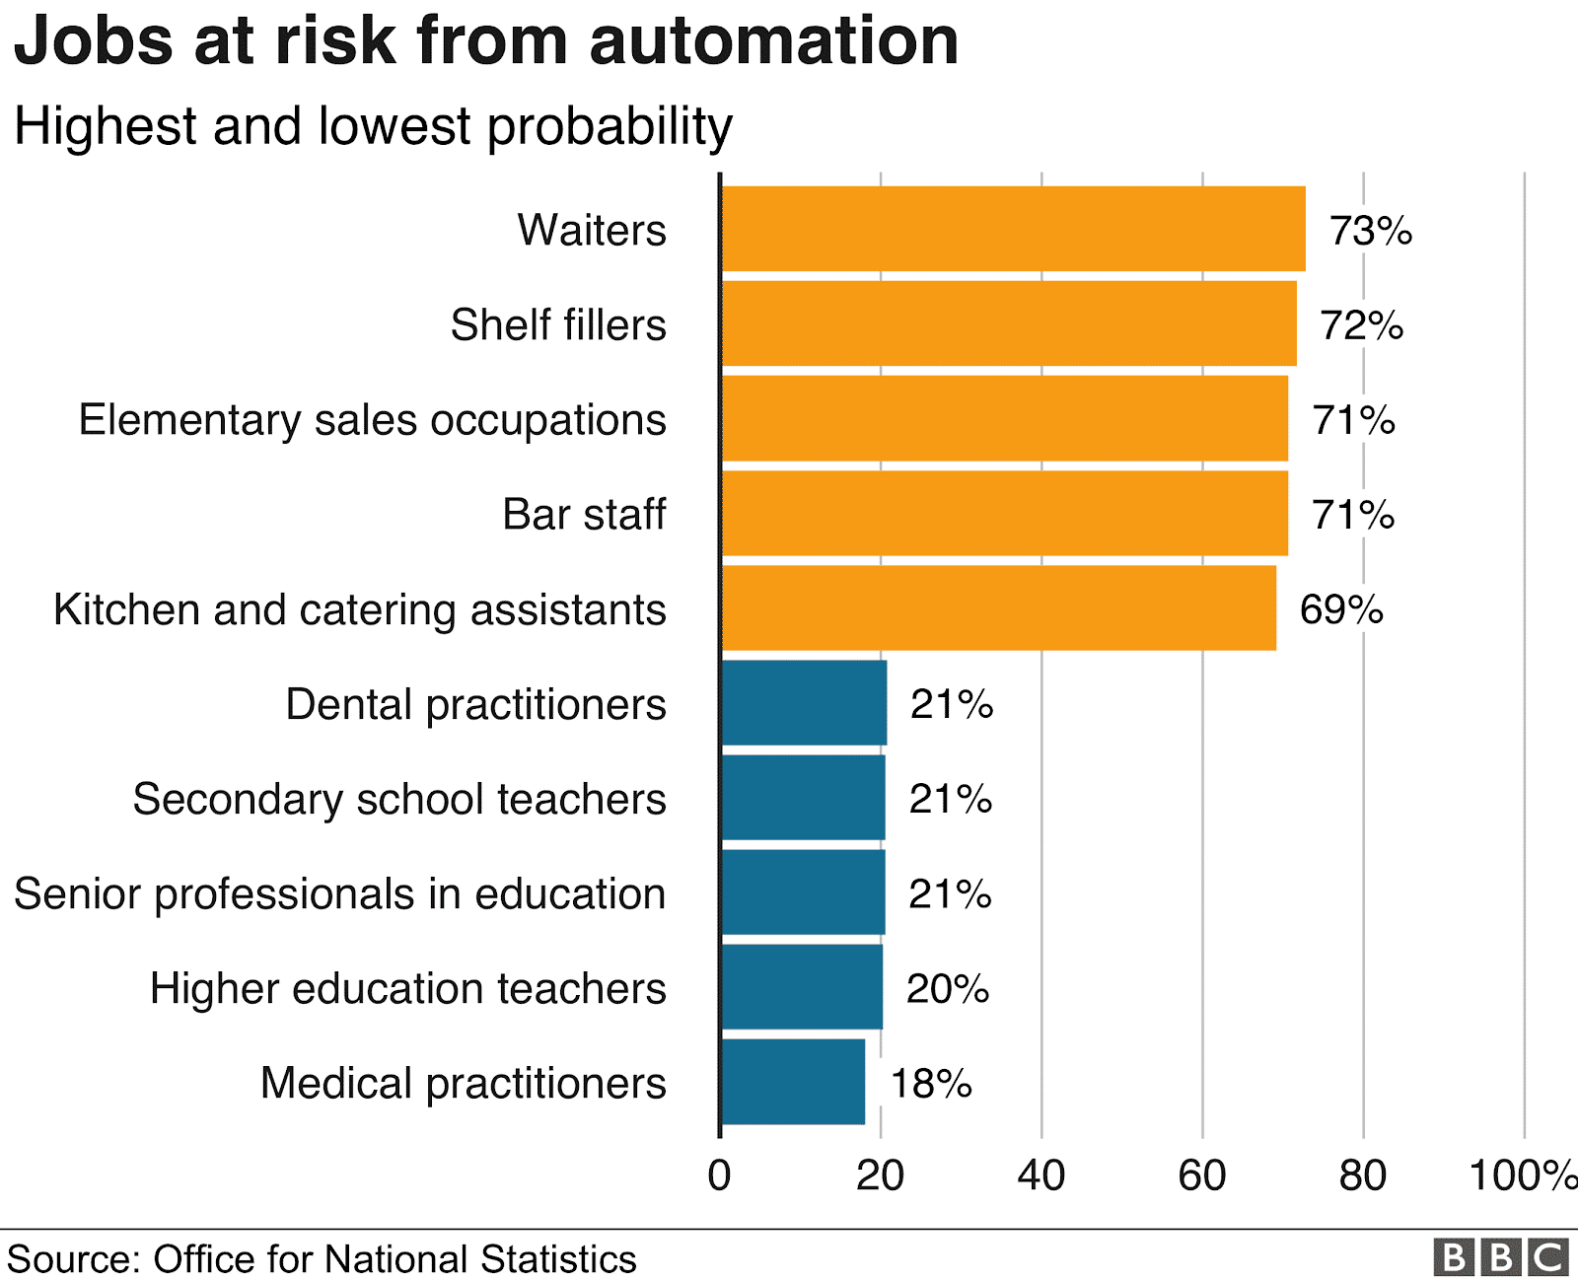
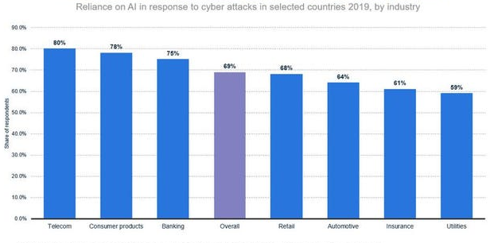
Considerable dangers of AI growth
The development of AI, particularly generative models, poses a huge threat to job security
Jobs which were considered human roles only can now be fully automated by AI with its intelligent capabilities acting as that “human factor”.
Organisations implementing AI into their cybersecurity leaves huge vulnerabilities as it has had very little testing.
Global damage from cybercrime is expected to reach $10.5 trillion withing 2025-2031
Scam email attacks based on ChatGPT have increased by 130%

Slide 5
Managing the risks posed by AI
Ethical
AI models must be trained on fair and diverse data to reduce any biases or inaccuracies in its decision making. Data used for training must be authentic, and if being trained on data from consumers, consent must be given
Particularly important for AI-based hiring decisions which are set to increase rapidly throughout industry.
Moral
Keeping a human involved in AI processing. The tools, though advanced, need constant oversight to ensure they are working as correctly intended without inaccuracies or bias.
It’s a moral obligation of those developing more advanced AI models to oversee their development and progression to prevent any algorithms from causing damage.
.Environmental
Limit and increase the efficiency of the data centres where AI processing takes place.
As AI is more widely adopted in the world, the number of data centres will be rapidly increase. The cooling of these centres can be hugely inefficient and the energy required has detrimental effects on the environment.

